Slide 1
Unit 3
Memory Management and Virtualization

Slide 2
Introduction to Memory Management
Program must be brought (from disk) into memory and placed into a process for it to run
OS loads the program into the memory and then only the CPU can access the instructions and the data from memory while executing the process
In a uni-programming system, main memory is divided into two parts: one part for the operating system and one part for the program currently being executed
In a multiprogramming system, the “user” part of the memory must be further subdivided to accommodate multiple processes
The task of subdivision is carried out dynamically by the operating system and it is known as memory management

Slide 3
Introduction to Memory Management
Memory manager in an OS effectively manages the memory. It
  Keeps track of used/unused part of memory.
  Allocate/de-allocate memory to processes.
  Manages swapping between main memory and disk.
  Protection and sharing of memory

Slide 4
Logical and Physical Address
Logical Address
The address that is generated by the CPU is commonly referred to as the Logical Address.
It is basically a virtual address. The logical address is basically the address of an instruction or data used by any program.
The logical address is virtual address as it does not exist physically, therefore, it is also known as Virtual Address.
This address is used as a reference to access the physical memory location by CPU.
The hardware device called Memory-Management Unit is used for mapping logical address to its corresponding physical address.

Slide 5
Logical and Physical Address
Physical Address
a real address in memory
Physical Address identifies a physical location of required data in a memory.
The user never directly deals with the physical address but can access by its corresponding logical address.
The user program generates the logical address and thinks that the program is running in this logical address but the program needs physical memory for its execution, therefore, the logical address must be mapped to the physical address by MMU before they are used.

Slide 6
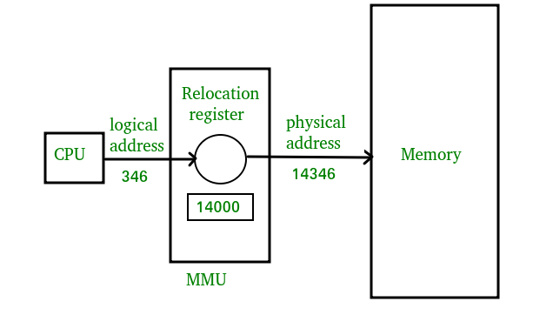
Logical and Physical Address

Slide 7
Physical and Logical Address Space
The term Logical Address Space is used for the set of all logical addresses generated by a program’s perspective.
The term Physical Address Space is used for all physical addresses corresponding to the logical addresses in a Logical address space.
The run-time mapping from virtual to physical addresses is done by hardware device called the memory-management unit (MMU)

Slide 8
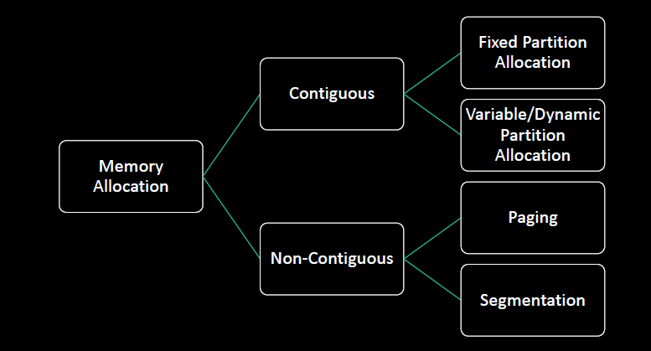
Memory Allocation Techniques

Slide 9
Contiguous Memory Allocation
The memory is usually divided into two partitions: one for the resident operating system and one for the user processes
We can place the operating system in either low memory or high memory(usually in low memory)
In this contiguous memory allocation, each process is contained in a single contiguous section of memory (i.e. memory resident program occupies a single contiguous block of physical memory.)
Contiguous Memory Allocation allocates consecutive blocks of memory to a file/process.
The memory is partitioned into blocks of different sizes to accommodate the programs.
Difficult to grow or shrink process
This partitioning is of two type:
  1. Fixed/Static Partition Allocation
  2. Variable/Dynamic Partition Allocation

Slide 10
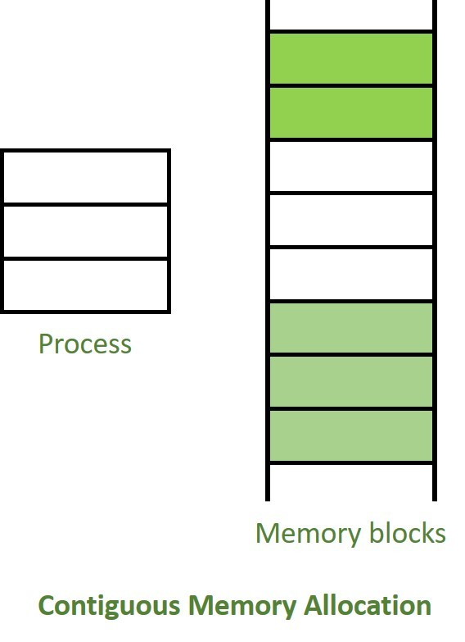
Contiguous Memory Allocation

Slide 11
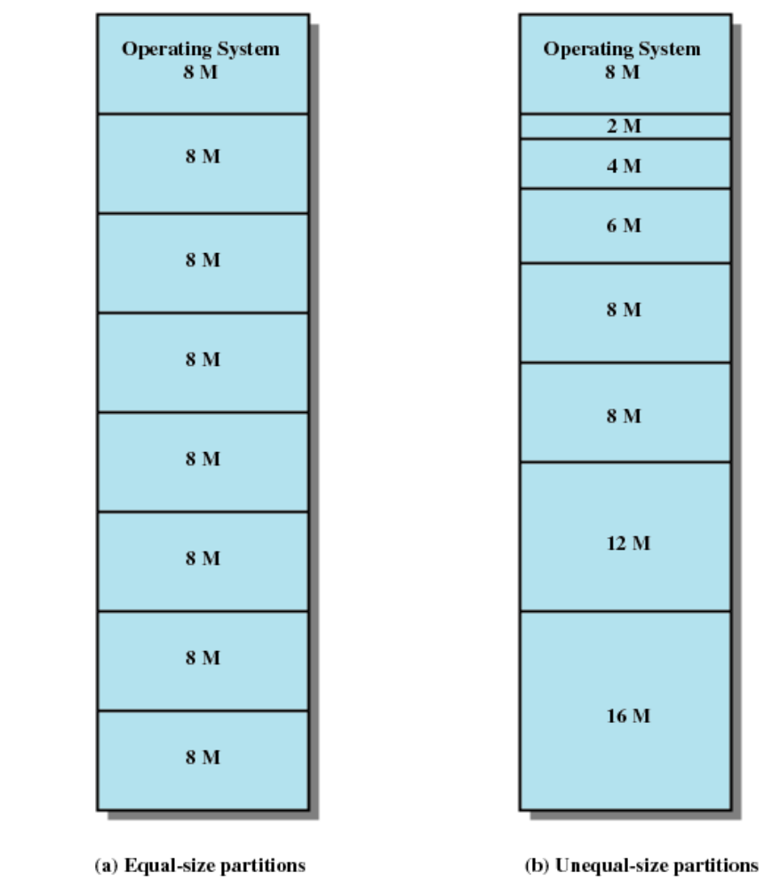
Contiguous Memory Allocation-Fixed Partition Allocation
The simplest way to manage the memory available for the processes is to partition memory into regions with fixed boundaries
In Fixed Partitioning, we divide the main memory into partitions, and the size of partitions can be different or equal.
A process whose size is less than or equal to the partition size can be loaded into that partition

Slide 12
Contiguous Memory Allocation-Fixed Partition Allocation
We divide the memory into several fixed size partitions where each partition will accommodate only one program for execution.
The number of programs (i.e. degree of multiprogramming) residing in the memory will be bound by the number of partitions.
When a program terminates, that partition is freed for another program waiting in a queue.
Equal-size partitions
  Because all partitions are of equal size, it does not matter which partition is used
Unequal-size partitions
  Can assign each process to the smallest partition within which it will fit
  Queue for each partition
  Processes are assigned in such a way as to minimize wasted memory within a partition

Slide 13
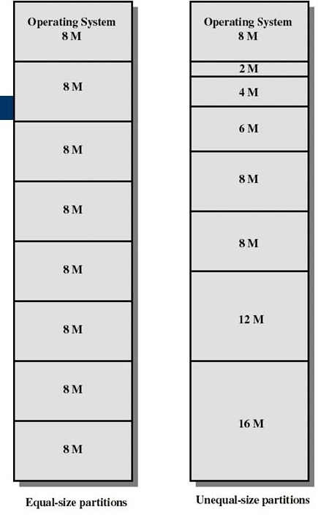
Contiguous Memory Allocation-Fixed Partition Allocation

Slide 14
Contiguous Memory Allocation-Fixed Partition Allocation
Advantages
Easy to implement: Algorithms needed to implement Fixed Partitioning are easy to implement.
Little OS Overhead: Processing of Fixed Partitioning requires lesser excess and indirect computational power.
Disadvantages
Internal Fragmentation: If the size of the process is lesser then the total size of the partition then some size of the partition get wasted and remain unused.
External Fragmentation: Frequent loading and unloading of programs causes free space to be broken into little pieces. The total unused space of various partitions cannot be used to load the processes even though there is space available but not in the contiguous form.

Slide 15
Contiguous Memory Allocation-Fixed Partition Allocation
Disadvantages
Limitation on the size of the process: If the process size is larger than the size of maximum sized partition then that process cannot be loaded into the memory. Therefore, a limitation can be imposed on the process size that is it cannot be larger than the size of the largest partition.
Degree of multiprogramming is less: By Degree of multi programming, we simply mean the maximum number of processes that can be loaded into the memory at the same time.

Slide 16
Contiguous Memory Allocation-Dynamic Partition
In this method, partitions are created dynamically to meet the requirements of each requesting process
When a process terminates or is swapped-out, the memory manager can return the vacated space to the pool of free memory area and can be provided to another process later
Holes (pieces of free memory) might be created during dynamic partitioning
Given a new process, the OS must decide which hole to use for new process

Slide 17
Contiguous Memory Allocation-Dynamic Partition
In this method, partitions are created dynamically to meet the requirements of each requesting process
When a process terminates or is swapped-out, the memory manager can return the vacated space to the pool of free memory area and can be provided to another process later
Holes (pieces of free memory) might be created during dynamic partitioning
Given a new process, the OS must decide which hole to use for new process

Slide 18
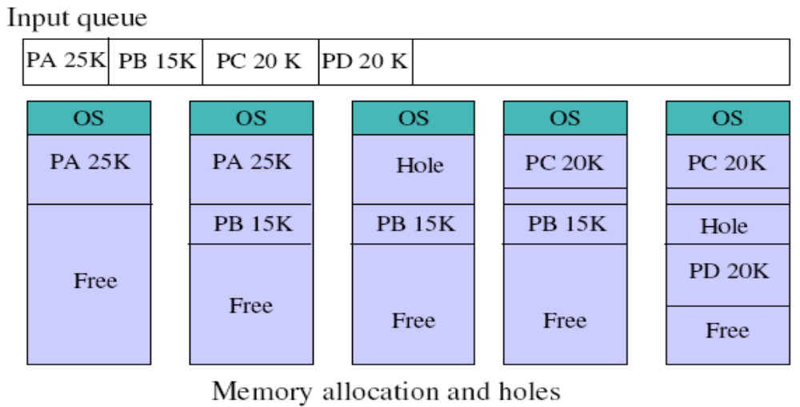
Contiguous Memory Allocation-Dynamic Partition

Slide 19
Fixed vs Variable Partitioning
Fixed partitioning | Variable partitioning
In multi-programming with fixed partitioning the main memory is divided into fixed sized partitions. | In multi-programming with variable partitioning the main memory is not divided into fixed sized partitions.
Only one process can be placed in a partition. | In variable partitioning, the process is allocated a chunk of free memory
It does not utilize the main memory effectively. | It utilizes the main memory effectively.
There is presence of internal fragmentation and external fragmentation. | There is external fragmentation.
It is more easier to implement. | It is less easier to implement.

Slide 20
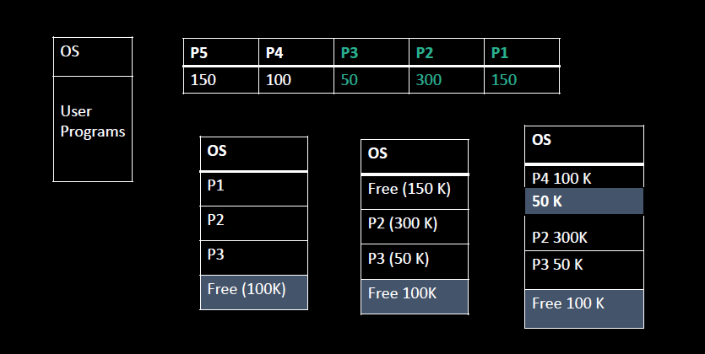
External Fragmentation
Frequent loading and unloading of programs causes free space to be broken into little pieces
External fragmentation exists when there is enough memory to fit a process in memory, but the space is not contiguous

Slide 21
Memory Allocation Policies
First-Fit
The memory manager allocates the first hole that is big enough. It stops the searching as soon as it finds a free hole that is large enough
Advantages: It is a fast algorithm because it searches as little as possible
Disadvantages: Not good in terms of storage utilization
2. Next-Fit
Variation of first fit
It works the same way as first fit, except that it keeps track of where it is whenever it finds a suitable hole

Slide 22
Memory Allocation Policies
Best-Fit
Allocate the smallest hole that is big enough for a process
The OS must search the entire list of holes or store the list sorted by size of the hole
Best fit try to find a hole that is close to the actual size needed.
Advantages: more storage utilization than first fit.
Disadvantages: slower than first fit because it requires searching whole list at time.

Slide 23
Memory Allocation Policies
4. Worst-Fit
Allocate the largest hole
It search the entire list, and takes the largest hole, rather than creating a tiny hole
It produces the largest leftover hole, which may be more useful
Advantages: some time it has more storage utilization than first fit and best fit.
Disadvantages: not good for both performance and utilization.
Note: Simulations show that first-fit(including next-fit) and best-fit usually yield better storage utilization than worst-fit. First-fit is generally faster than best-fit

Slide 24
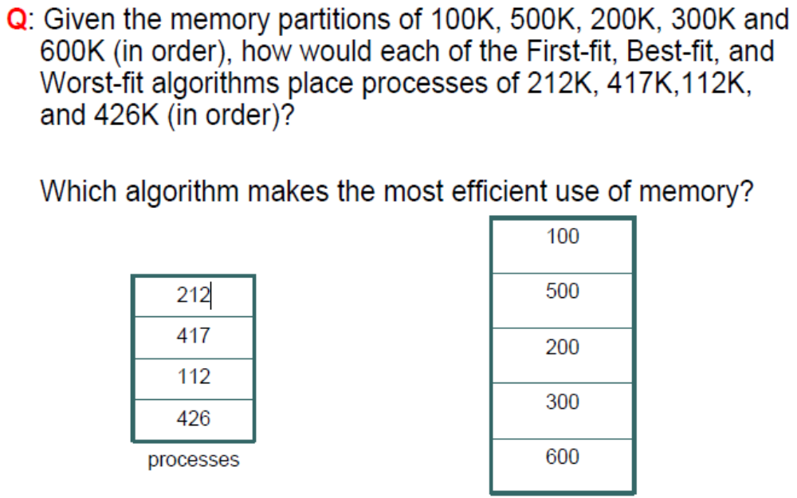
Memory Allocation Policies : Problem

Slide 25
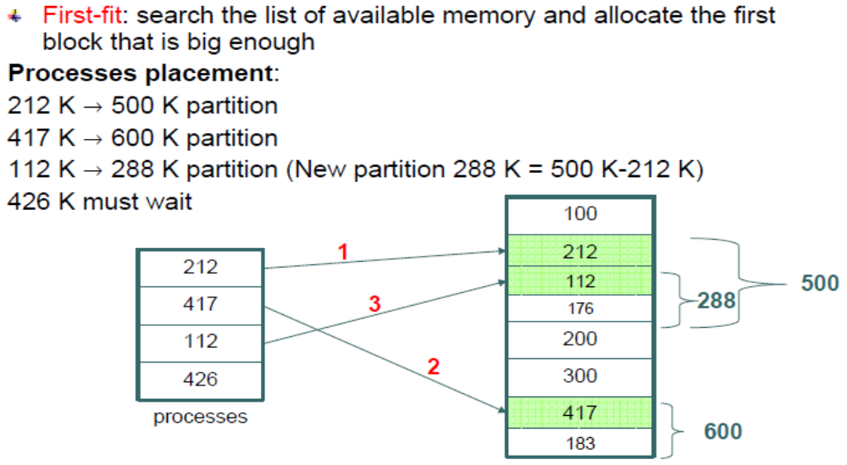
Memory Allocation Policies : Solution

Slide 26
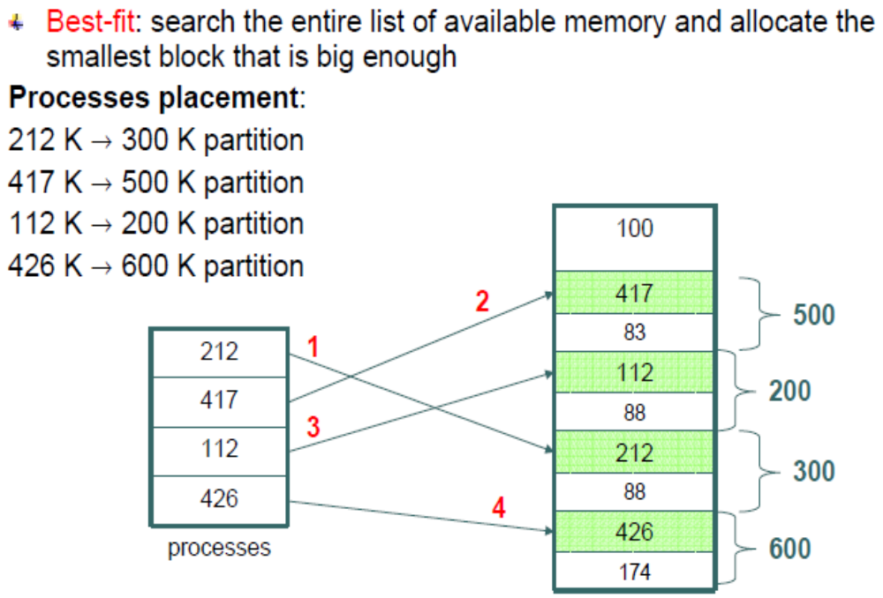
Memory Allocation Policies : Solution

Slide 27
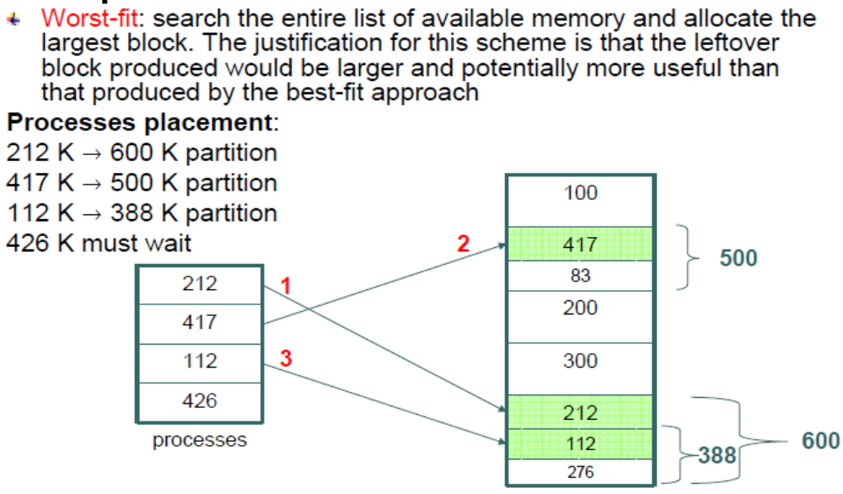
Memory Allocation Policies : Solution

Slide 28
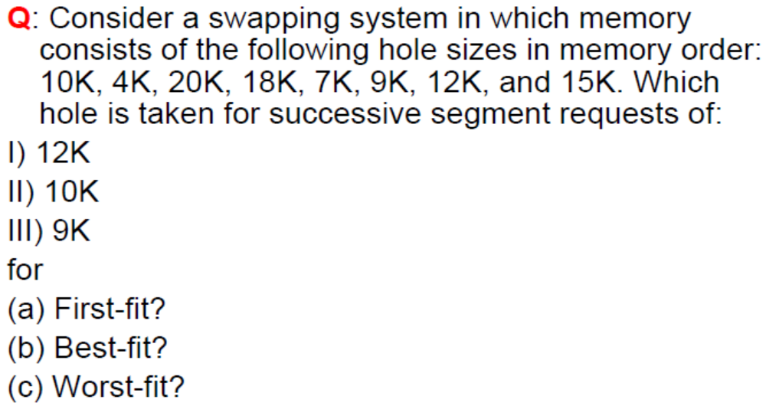
Memory Allocation Policies : Problem

Slide 29
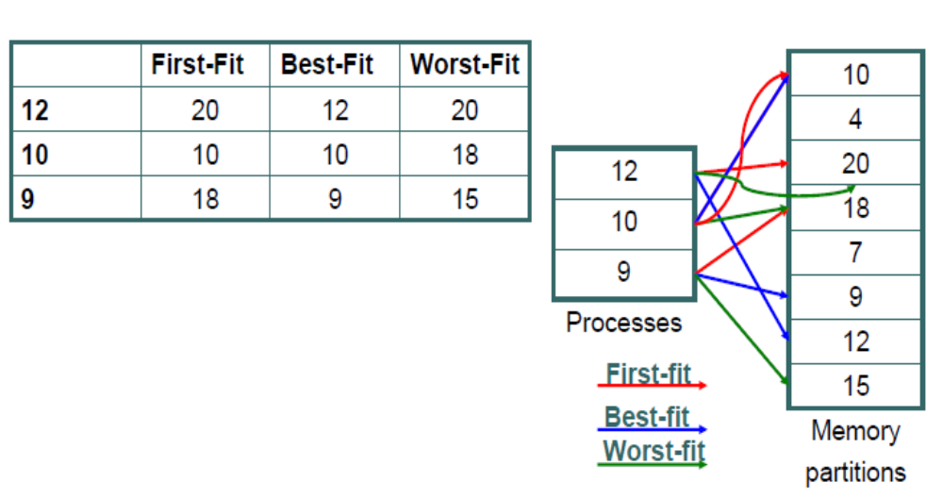
Memory Allocation Policies : Solution

Slide 30
Memory Protection: Base and Limit Registers
Any attempt by a program executing in user mode to access operating-system memory or other users' memory results in a trap to the operating system, which treats the attempt as a fatal error
The base and limit registers can be loaded only by the operating system, which uses a special privileged instruction.
Since privileged instructions can be executed only in kernel mode, and since only the operating system execute in kernel mode, only the operating system can load the base and limit registers.
This scheme allows the operating system to change the value of the registers but prevents user programs from changing the registers' contents.

Slide 31
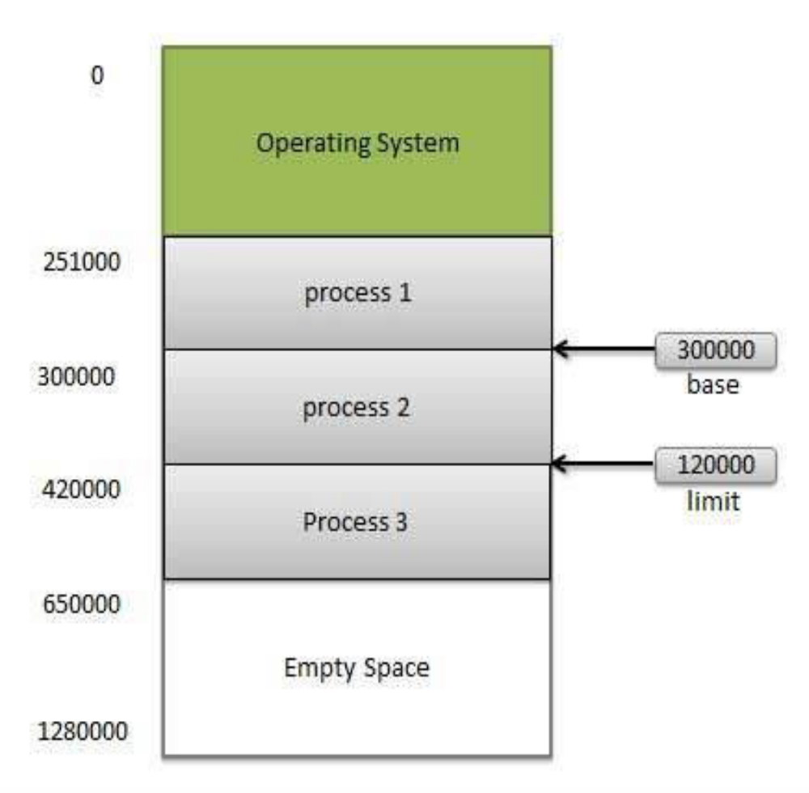
Memory Protection: Base and Limit Registers
For example, if the base register holds 300000and the limit register is 120000, then the program can legally access all addresses from 300000 through 419999.

Slide 32
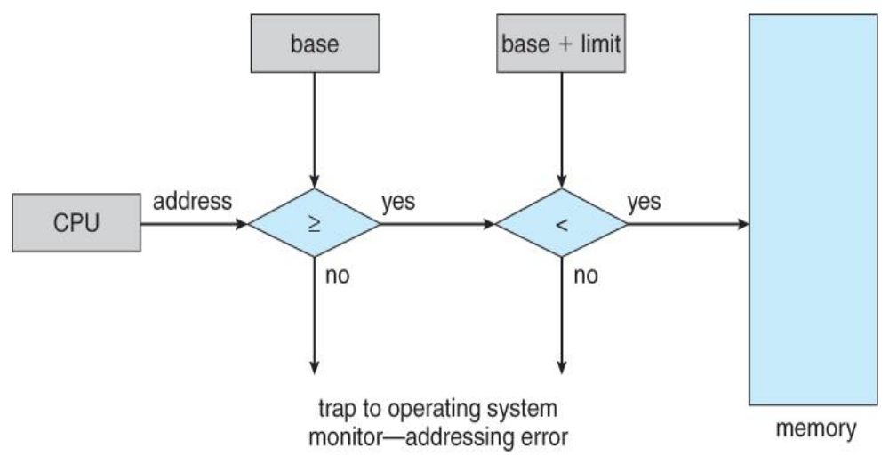
Memory Protection: Base and Limit Registers

Slide 33
Memory Fragmentation
Memory Fragmentation is a problem where the free memory space is fragmented when processes are loaded and unloaded from memory.
Processes can’t be assigned to memory blocks due to their small size, and the memory blocks stay unused.
There are mainly two types of fragmentation in the operating system. These are as follows:
Internal Fragmentation
External Fragmentation

Slide 34
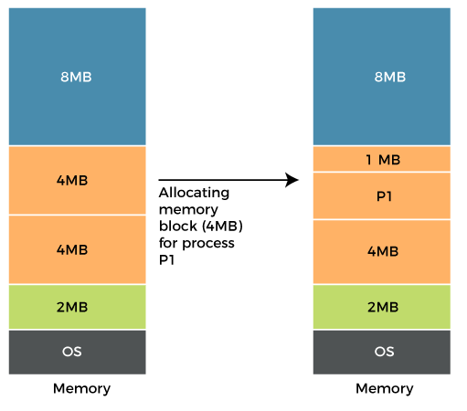
Memory Fragmentation-Internal Fragmentation
When a process is allocated to a memory block, and if the process is smaller than the amount of memory requested, a free space is created in the given memory block.
Due to this, the free space of the memory block is unused, which causes internal fragmentation.
Consider figure alongside memory allocation in RAM is done using fixed partitioning (i.e., memory blocks of fixed sizes). 2MB, 4MB, 4MB, and 8MB are the available sizes.
The Operating System uses a part of this RAM.

Slide 35
Memory Fragmentation-Internal Fragmentation
Example
Let's suppose a process P1 with a size of 3MB arrives and is given a memory block of 4MB.
As a result, the 1MB of free space in this block is unused and cannot be used to allocate memory to another process.
It is known as internal fragmentation.

Slide 36
Memory Fragmentation-Internal Fragmentation
Solution
The problem of internal fragmentation may arise due to the fixed sizes of the memory blocks.
It may be solved by assigning space to the process via dynamic partitioning.
Dynamic partitioning allocates only the amount of space requested by the process. As a result, there is no internal fragmentation.

Slide 37
Memory Fragmentation-External Fragmentation
External fragmentation happens when a dynamic memory allocation method allocates some memory but leaves a small amount of memory unusable.
The quantity of available memory is substantially reduced if there is too much external fragmentation.
There is enough memory space to complete a request, but it is not contiguous. It's known as external fragmentation.

Slide 38
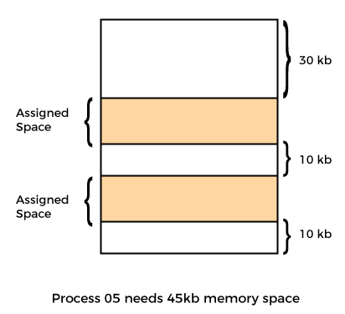
Memory Fragmentation-External Fragmentation
Example
Consider the figure alongside.
We can see that there is sufficient space (50 KB) to run a process (05) (need 45KB), but the memory is not contiguous.
We can use compaction, paging, and segmentation to use the free space to execute a process.

Slide 39
Dealing With Fragmentation
External fragmentation can be mined by compaction and coalescing
External fragmentation can be prevented by mechanisms such as segmentation and paging
Internal fragmentation can be maimed by having partitions of several sizes and assigning a program based on the best fit. However, still internal fragmentation is not fully eliminated

Slide 40
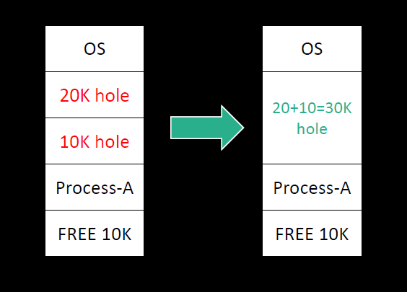
Coalescing
The process of merging two adjacent holes to form a single larger hole is called coalescing.

Slide 41
Compaction
Drawback of coalescing : Even when holes are coalesced, no individual hole may be large enough to hold the process, although the sum of holes is larger than the storage required for a process
It is possible to combine all the holes into one big one by moving all the processes downward as far as possible; this technique is called memory compaction.
Drawbacks:
  Reallocation info must be maintained
  System must stop everything during compaction
  Memory compaction requires lots of CPU time

Slide 42
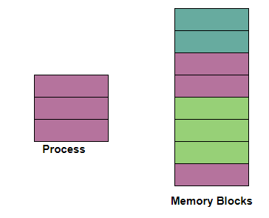
Non-Contiguous Memory Allocation
In non-contiguous memory allocation, different parts of a process is allocated different places in Main Memory.
With the help of Non-contiguous memory allocation, a process is allowed to acquire several memory blocks at different locations in the memory according to its need.
In the non-contiguous memory allocation, the available free memory space is distributed here and there which means that all the free memory space is not in one place.

Slide 43
How to deal with insufficient Memory?
Swapping
  temporarily move processes to disk
  require dynamic relocation
Memory Compaction
  move blocks around to create larger holes
Virtual Memory
  allow programs larger than physical memory
  portions of programs loaded as needed

Slide 44
Virtual Memory
Virtual memory is a memory management technique that allows programs larger than physical memory to be executed
Virtual Memory is a space where large programs can store themselves in form of pages while their execution and only the required pages or portions of processes are loaded into the main memory
Virtual memory takes the advantage of the fact that processes typically do not use all the allocated memory at once.
In other words, most processes never need all their pages at once.
Logical address space can therefore be much larger than physical address space

Slide 45
Paging
Paging is a storage mechanism that allows OS to retrieve processes from the secondary storage into the main memory in the form of pages.
The main idea behind the paging is to divide each process in the form of pages. The main memory will also be divided in the form of frames.
One page of the process is to be stored in one of the frames of the memory. The pages can be stored at the different locations of the memory but the priority is always to find the contiguous frames or holes.
Pages of the process are brought into the main memory only when they are required otherwise they reside in the secondary storage.

Slide 46
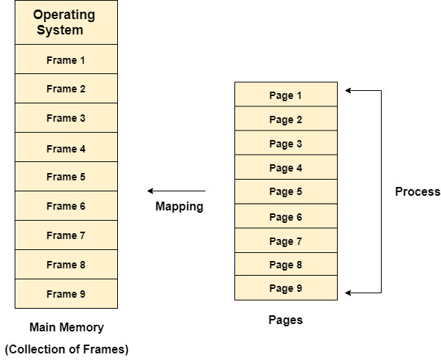
Paging

Slide 47
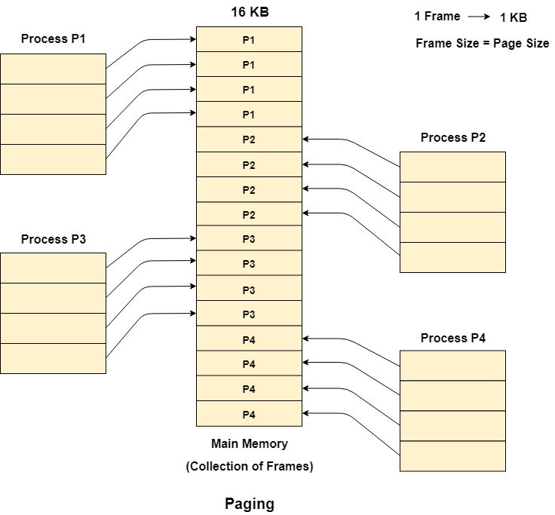
Paging-Example
Let us consider the main memory size 16 KB and Frame size is 1 KB therefore the main memory will be divided into the collection of 16 frames of 1 KB each.
There are 4 processes in the system that is P1, P2, P3 and P4 of 4 KB each. Each process is divided into pages of 1 KB each so that one page can be stored in one frame.
Initially, all the frames are empty therefore pages of the processes will get stored in the contiguous way.

Slide 48
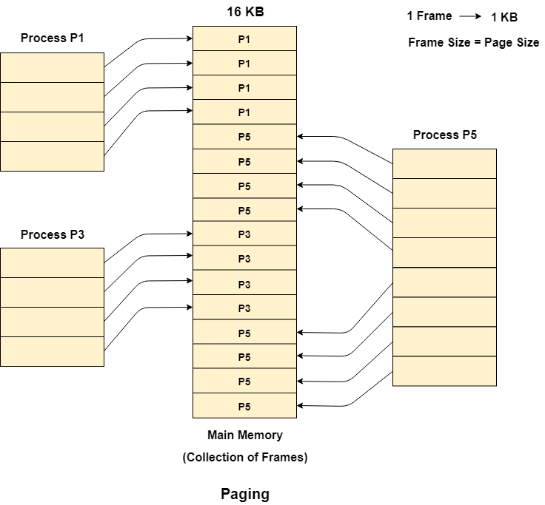
Paging-Example
Let us consider that, P2 and P4 are moved to waiting state after some time.
Now, 8 frames become empty and therefore other pages can be loaded in that empty place.
Assume process P5 of size 8 KB (8 pages) is waiting inside the ready queue.
Given the fact that, we have 8 non contiguous frames available in the memory and paging provides the flexibility of storing the process at the different places. Therefore, we can load the pages of process P5 in the place of P2 and P4.

Slide 49
Paging
OS needs to do two things for paging
1. Mapping the pages to frame, maintain a page table
2. Translate the virtual address (contiguous) into physical address (not so easy as the physical address for a process is scattered all over the memory)

Slide 50
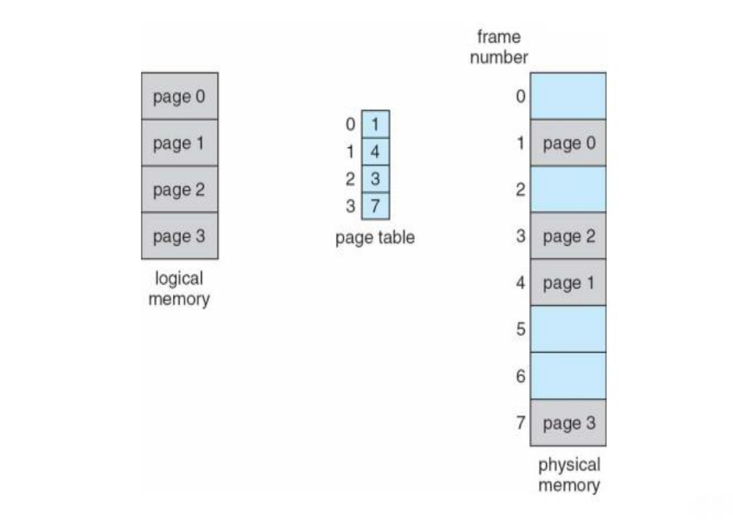
Page Table
Page Table is a data structure used by the virtual memory system to store the mapping between logical addresses and physical addresses.
Logical addresses are generated by the CPU for the pages of the processes therefore they are generally used by the processes.
Physical addresses are the actual frame address of the memory. They are generally used by the hardware or more specifically by RAM subsystems.

Slide 51
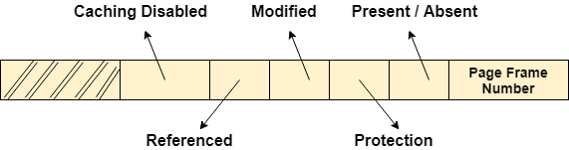
Page Table Entry(PTE)
Page table has page table entries where each page table entry stores a frame number and many other bits representing some extra information regarding the page.

Slide 52
Page Table Entry(PTE)
Frame number: The actual page frame number.
Present (1) / Absent (0) bit: Defines whether the virtual page is currently mapped or not.
Protection bit: Kinds of access permission; read/write/execution.
Modified bit/dirty bit: Defines the changed status of the page since last access.
Referenced bit: is set when a page is referenced. Used for replacement strategy.
Caching disabled: allows caching to be disabled for the page
The size of PTE varies from computer to computer, but 32 bits (4 bytes) is a common size

Slide 53
Characteristics of the Page Table
It is stored in the main memory.
Generally; the Number of entries in the page table = the Number of Pages in which the process is divided.
PTBR means Page Table Base Register and it is basically used to hold the base address for the page table of the current process.
Each process has its own independent page table.

Slide 54
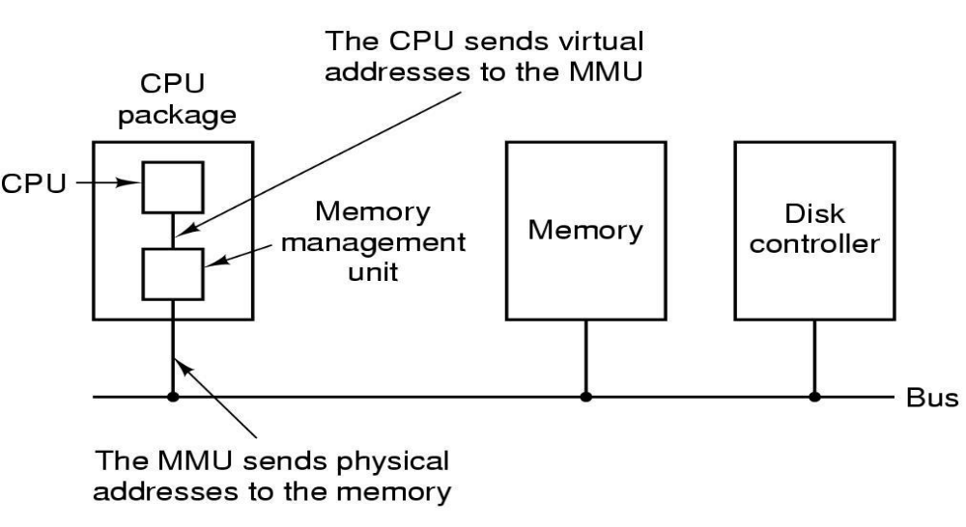
Address Translation
The conversion from virtual address to the physical address is done by MMU(Memory Management Unit).

Slide 55
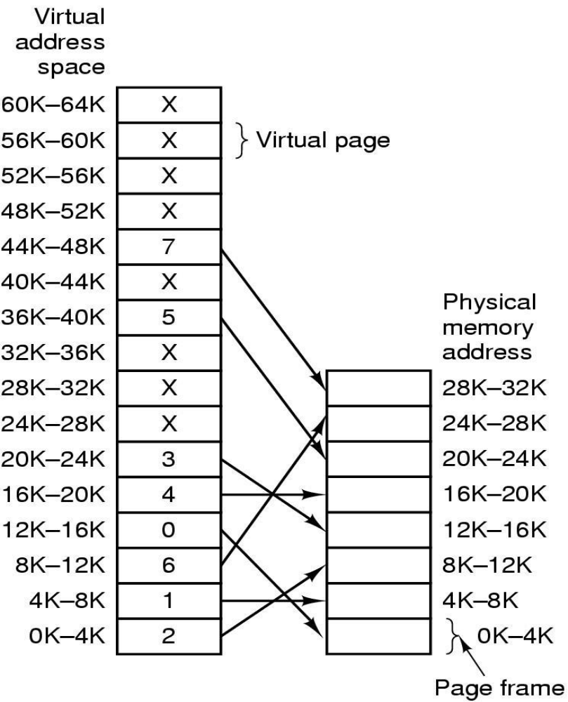
Address Translation-Example
64KB program, 4 KB pages,
32 KB physical memory, 16 virtual pages and 8 page frames
Range marked 0k-4k means that the physical or virtual addresses in that page are 0 to 4095

Slide 56
Address Translation-Example
Consider an instruction MOV REG,0
Virtual address 0 is sent to MMU. The MMU sees that this virtual address falls in page 0 (0 to 4095), which is mapped to page frame 2(8192 to 12287)
Thus it transforms the address to 8192 & outputs 8192onto the bus
Similarly MOV REG, 8192 (virtual page 2) is effectively transformed into MOV REG, 24576(physical page frame 6)
Also, a virtual address 20500 is 20 bytes from the start of the virtual page 6 (virtual addresses 20480 to 24575) and maps onto physical address 12288+20=12308

Slide 57
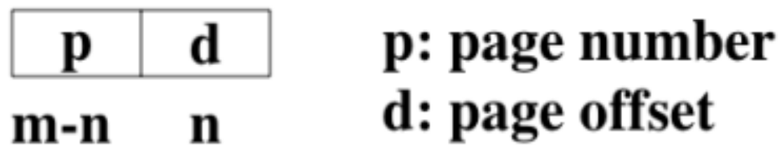
Address Translation
Every address generated by the CPU is divided into two parts:
  page number (p)
  2. page offset (d)
Virtual address space of size 2^{m} bytes and a page of size 2^{n} , then the high order m-n bits of a virtual address select the page, and the low order n bits select the offset in the page
The page number is used as an index into a page table
The page table contains the base address of each page in physical memory.
This base address is combined with the page offset to define the physical memory address that is sent to the memory unit

Slide 58
Address Translation
Let us see how the incoming virtual address 8196(0010000000000100 in binary) is mapped to physical address 24580
Incoming 16-bit virtual address is split into 4-bit page number and 12-bit offset
With 4-bits, we can have 16 pages and with 12-bits for the offset, we can address all 4096 bytes within a page
The page number is used as an index into the page table, gives number of virtual pages.
Page table contains Present/Absent bit also to keep track of whether a particular page number is present in memory or not

Slide 59
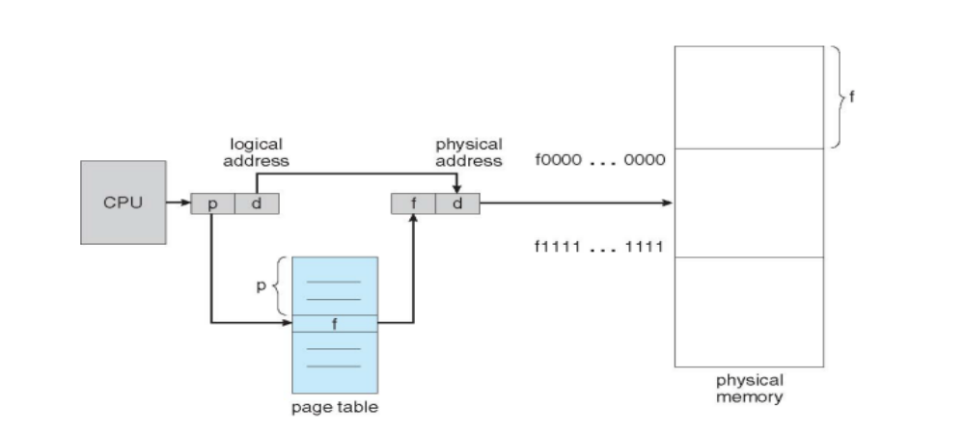
Address Translation

Slide 60
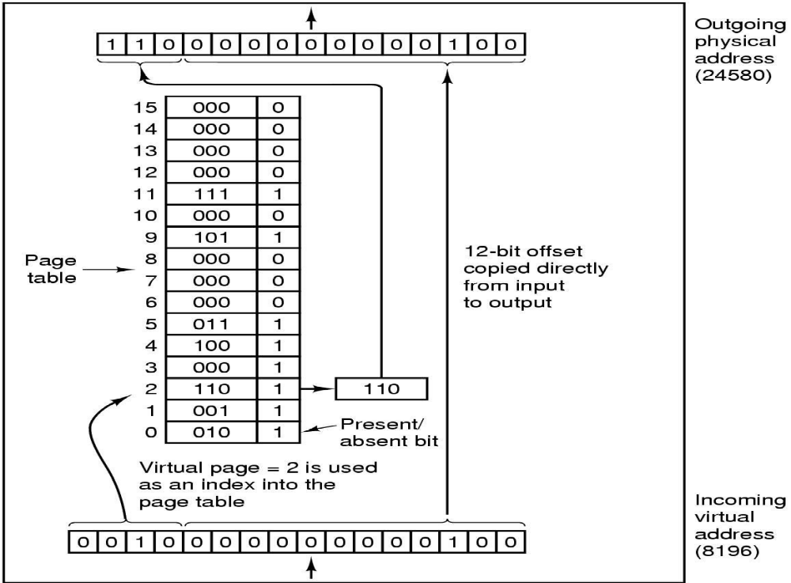
Address Translation

Slide 61
Page Fault
When the page (data) requested by a program is not available in the memory, it is called as a page fault
In the previous example, what happens if a program references an unmapped address? For example the instruction
  MOV REG, 32780
  which is 12 byte within virtual page 8 (starting at 32768).
The MMU notices that the page is unmapped and causes the CPU to trap the OS
This trap is called page fault
We know that there is page fault by consulting a page table. If there is no entry in the page table or the entry points to DISK, we know that there is page fault

Slide 62
Issues with Paging
In any paging system, two major issues must be faced:
1.Many memory access (slower process)
For each memory access with virtual memory, we have to :
  Access the page table in RAM
  Translate the address
  Access the data in RAM
This is a lot of work for every memory access
The bottom-line is that paging can make computer slower
Solution: Use Translation Lookaside Buffer (TLB)

Slide 63
Issues with Paging
2.Large page tables
If the virtual address space is large, the page table will be large
For example, if we use 32 bit virtual addresses and 4KB page size, we will have around 1 million page table entries
Each PTE(Page Table Entry) is about 4 bytes, making a page table of size 4MB
4MB is not bad, but each program need its own page table (100 programs=400MB)
Solution:
  Multilevel Page Tables
  Inverted Page Tables
  Hashing Page Tables

Slide 64
Translation Lookaside Buffer (TLB)
Every virtual memory reference can cause two physical memory access: one to fetch the appropriate page table entry and one to fetch the desired data
Most program tend to make a large number of references to a smaller number of pages
That is, only a small fraction of the page table entries are heavily read; the rest are barely used
Using this observation, a solution has been devised to equip computer with a small hardware device for mapping virtual addresses to physical addresses without going through page table
The device is called Translation Lookaside Buffer (TLB) or sometimes called an associative memory

Slide 65
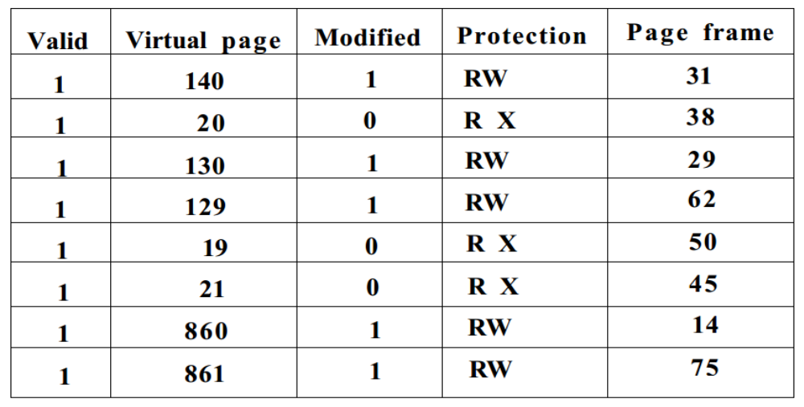
Translation Lookaside Buffer (TLB)

Slide 66
Translation Lookaside Buffer (TLB)
TLB is usually inside the MMU and consists of small number of entries
Each entry contains information about one page, including a virtual page number, a bit that is set when the page is modified, the protection code, and physical frame in which the page is located
When a virtual address is provided to the MMU for translation, the hardware first checks to see if its virtual page number is present in the TLB
If a valid match is found, and the access does not violate the protection bits, the page frame is taken directly form the TLB
If virtual page frame is present in table but instruction is trying to write on a read only page, it generates a protection fault
If virtual page number is not found in the TLB, MMU detects the miss and does an ordinary page table lookup

Slide 67
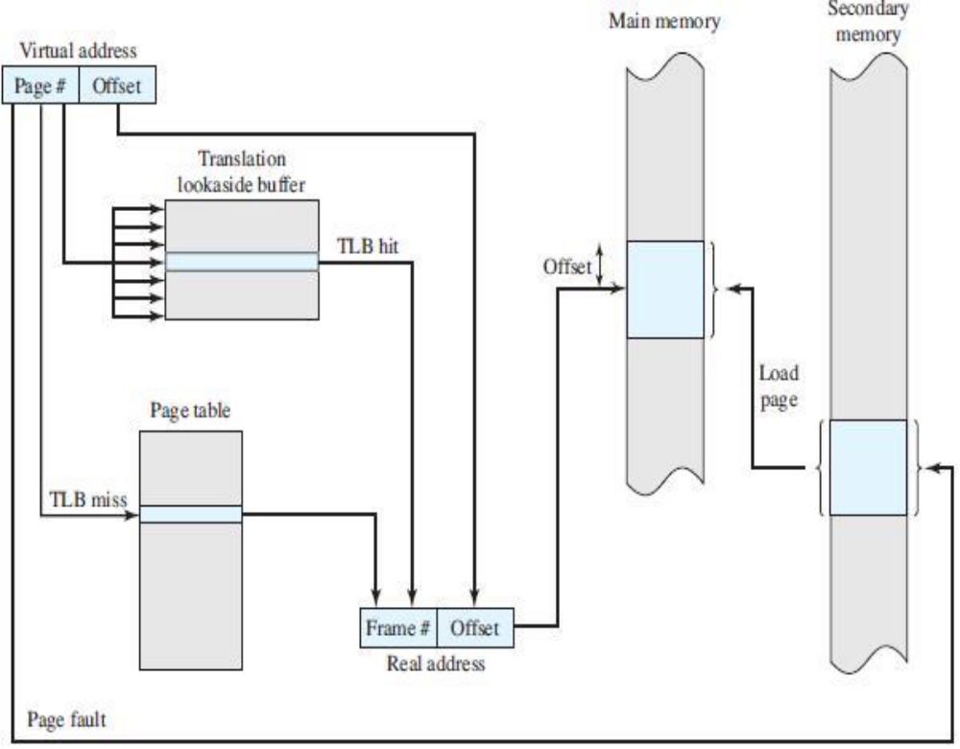

Slide 68
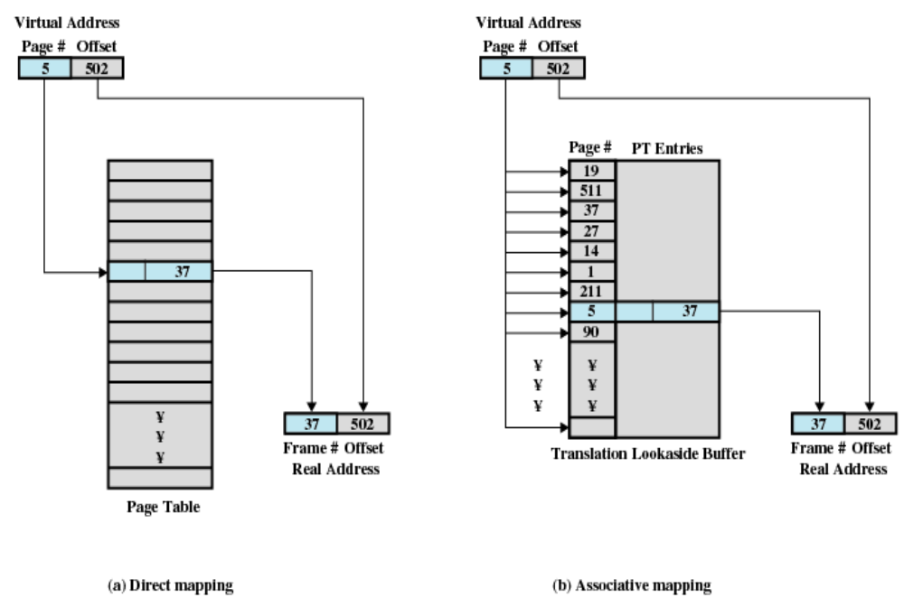
Direct vs Associative Mapping

Slide 69
Demand Paging
Load pages to memory only when they are needed
With demand-paged virtual memory, pages are only loaded when they are demanded during program execution; pages that are never accessed are thus never loaded into physical memory.
A demand-paging system is similar to a paging system with swapping where processes reside in secondary memory
When we want to execute a process, we swap it into memory
Rather than swapping the entire process into memory, however, we use a lazy swapper
A lazy swapper never swaps a page into memory unless that page will be needed
Its better to use the term pager than swapper in demand pages since we are viewing a process as a sequence of pages, rather than as one large contiguous address space

Slide 70
Demand Paging
We must develop two algorithm for demand paging
frame-allocation algorithm
If we have multiple processes in memory, we must decide how many frames to allocate to each process
page-replacement algorithm
Further, when page replacement is required, we must select the frames that are to be replaced

Slide 71
Frame Allocation Algorithm
Frame allocation algorithm determines how many frames to give each process
Each process needs some minimum number of frames to operate correctly
Two major allocation schemes:
  1. Fixed Allocation
  2. Priority Allocation

Slide 72
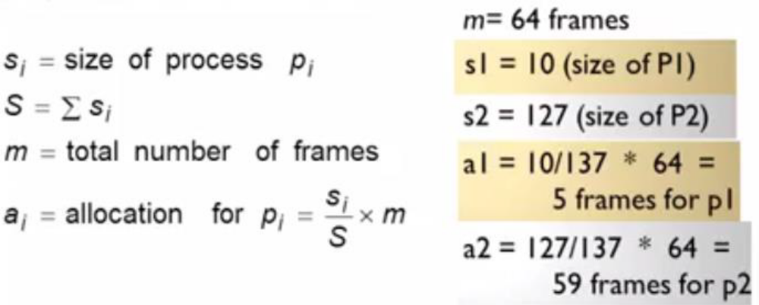
Frame Allocation Algorithm
1.Fixed Allocation
Equal Allocation : For examples, if there are 100 frames (after allocating frames for OS), and 5 processes, give each process 20 frames
Proportional Allocation : Allocate according to size of process

Slide 73
Frame Allocation Algorithm
2. Priority Allocation
Uses proportional allocation scheme using priorities rather than size
Higher priority process gets more frames than lower priority process

Slide 74
Thrashing
If a process does not have “enough” pages in memory (less number of frames allocated), the page fault rate is very high
  Page fault to get page
  Replace existing frame
  But quickly need replaced frame back
  This leads to :
    low CPU utilization
    OS thinks that it needs to increase the increase the degree of multiprogramming and adds another process to the system
Thrashing is a condition where a process is busy swapping pages in and out
Task: How can you deal with this??

Slide 75
Page Replacement
When a page fault occurs, the OS has to choose a page to remove from memory to make room for incoming page
If the page to be removed has been modified while in memory (check the modified bit), it must be rewritten to the disk to make the copy of the page in the disk up to date
If the page has not been changed, the disk copy is up to date and no rewrite is needed, the page to be brought in simply replaces the old page in memory
Choosing a page randomly to be removed might not be effective. We will discuss the some algorithms in doing so.

Slide 76
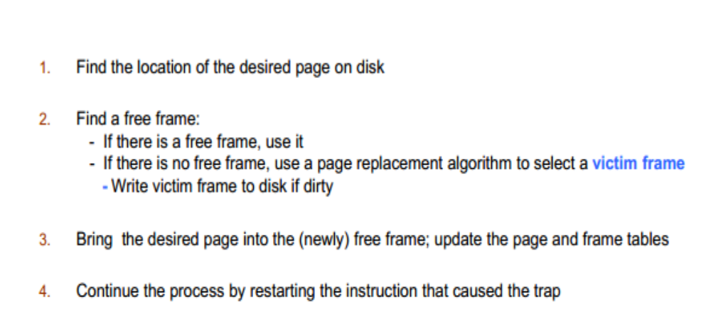
Page Replacement Procedure

Slide 77
Page Replacement Algorithm
1.The Optimal Page Replacement (OPR) algorithm
2.The least recently used (LRU) page replacement algorithm
3.First-In First-Out page (FIFO) replacement algorithm
4.Second Chance Page (SCP) replacement algorithm
5.The clock page replacement algorithm
Note: We evaluate an algorithm by running it on a particular string of memory references and computing the number of page faults

Slide 78
Page Replacement Algorithm-The Optimal Page Replacement (OPR) algorithm
It is the best possible page replacement algorithm, which is easy to describe but impossible to implement
Replace page that will not be used for longest period of time
For example, a page that is not going to be used for the next 6 seconds will be swapped out over a page that is going to be used within the next 0.4 seconds.
Optimal page replacement is perfect, but not possible in practice as the operating system cannot know future requests. The use of Optimal Page replacement is to set up a benchmark so that other replacement algorithms can be analyzed against it.

Slide 79
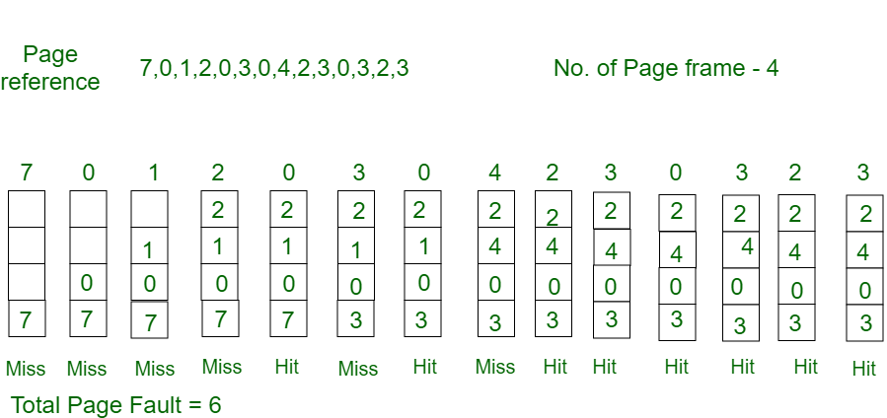
Page Replacement Algorithm-The Optimal Page Replacement (OPR) algorithm
Consider the page references 7, 0, 1, 2, 0, 3, 0, 4, 2, 3, 0, 3, 2, with 4 page frame. Find number of page fault.

Slide 80
Page Replacement Algorithm-The Optimal Page Replacement (OPR) algorithm-Example
Consider page frame size is 3 and the reference string is 7,0,1,2,0,3,0,4,2,3,0,3,0,3,2,1,2,0,1,7,0,1. Find number of page fault.

Slide 81
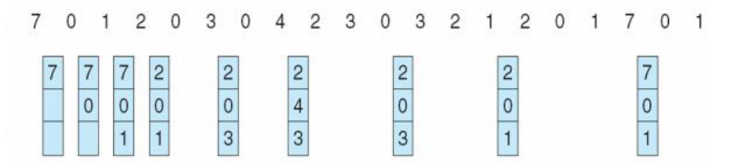
Page Replacement Algorithm-The Optimal Page Replacement (OPR) algorithm-Example
Consider page frame size is 3 and the reference string is 7,0,1,2,0,3,0,4,2,3,0,3,0,3,2,1,2,0,1,7,0,1. Find number of page fault.

Slide 82
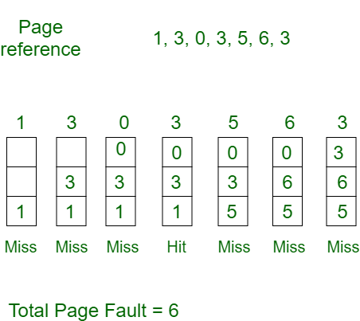
Page Replacement Algorithm- First In First Out(FIFO) Page Replacement Algorithm
This is the simplest page replacement algorithm.
In this algorithm, the operating system keeps track of all pages in the memory in a queue, the oldest page is in the front of the queue.
When a page needs to be replaced page in the front of the queue is selected for removal.

Slide 83
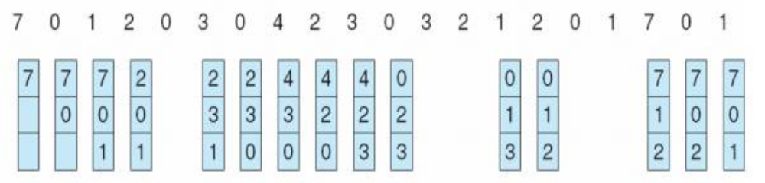
Page Replacement Algorithm-First In First Out(FIFO) Page Replacement Algorithm
Consider page frame size is 3 and the reference string is 7,0,1,2,0,3,0,4,2,3,0,3,0,3,2,1,2,0,1,7,0,1. Find number of page fault.
There are 15 page faults in this case

Slide 84
Page Replacement Algorithm-Least Recently Used(LRU) Page Replacement Algorithm
Use past knowledge rather than future
Replace page that has not been used in the most amount of time
1. Counter implementation
  Every page entry has a counter; every time page is referenced through this entry, copy the clock into the counter-When a page needs to be changed, look at the counters to find smallest value
2. Stack Implementation
  maintaining a stack of page references

Slide 85
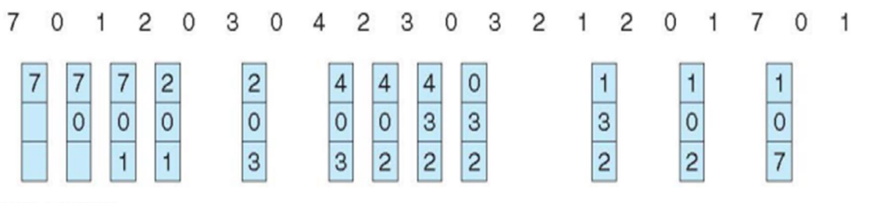
Page Replacement Algorithm-Least Recently Used(LRU) Page Replacement Algorithm-Example
Page frame size is 3 and the reference string is 7,0,1,2,0,3,0,4,2,3,0,3,0,3,2,1,2,0,1,7,0,1

Slide 86
Page Replacement Algorithm-Second Chance Page (SCP) Replacement Algorithm
It can be implemented by adding a “second chance” bit to each memory frame-every time the frame is considered (due to a reference made to the page inside it).
This bit is set to 1, which gives the page a second chance, as when we consider the candidate page for replacement, we replace the first one with this bit set to 0 (while zeroing out bits of the other pages we see in the process).
Thus, a page with the “second chance” bit set to 1 is never replaced during the first consideration and will only be replaced if all the other pages deserve a second chance too!
Implementation:
  Add a "second chance" bit to each memory frame.
  Each time a memory frame is referenced, set the "second chance" bit to ONE (1) - this will give the frame a second chance.
  A new page read into a memory frame has the second chance bit set to ZERO (0)
  When you need to find a page for removal, look in a round robin manner in the memory frames:
    If the second chance bit is ONE, reset its second chance bit (to ZERO) and continue.
    If the second chance bit is ZERO, replace the page in that memory frame.

Slide 87
Page Replacement Algorithm-Second Chance Page (SCP) Replacement Algorithm
Let’s say the reference string is 0 4 1 4 2 4 3 4 2 4 0 4 1 4 2 4 3 4 and we have 3 frames.
Initially, all frames are empty so after first 3 passes they will be filled with {0, 4, 1} and the second chance array will be {0, 0, 0} as none has been referenced yet.
Pass-4: Frame={0, 4, 1}, second_chance = {0, 1, 0} [4 will get a second chance], No page needed to be updated so the candidate is still page in frame 0, pf = 3 (No increase in page fault number).
Pass-5: Frame={2, 4, 1}, second_chance= {0, 1, 0} [0 replaced; it’s second chance bit was 0, so it didn’t get a second chance], pf=4
Pass-6: Frame={2, 4, 1}, second_chance={0, 1, 0}, pf=4 (No change)
Pass-7: Frame={2, 4, 3}, second_chance= {0, 0, 0} [4 survived but it’s second chance bit became 0], pf=5

Slide 88
Page Replacement Algorithm-Second Chance Page (SCP) Replacement Algorithm
Let’s say the reference string is 0 4 1 4 2 4 3 4 2 4 0 4 1 4 2 4 3 4 and we have 3 frames.
Pass-8: Frame={2, 4, 3}, second_chance= {0, 1, 0} [4 referenced again], pf=5
Pass-9: Frame={2, 4, 3}, second_chance= {1, 1, 0} [2 referenced again], pf=5
Pass-10: Frame={2, 4, 3}, second_chance= {1, 1, 0}, pf=5 (no change)
Pass-11: Frame={2, 4, 0}, second_chance= {0, 0, 0}, pf=6 (2 and 4 got second chances)
Pass-12: Frame={2, 4, 0}, second_chance= {0, 1, 0}, pf=6 (4 will again get a second chance)
Pass-13: Frame={1, 4, 0}, second_chance= {0, 1, 0}, pf=7 (pf updated)
Page-14: Frame={1, 4, 0}, second_chance= {0, 1, 0}, pf=7 (No change)
Page-15: Frame={1, 4, 2}, second_chance= {0, 0, 0}, pf=8 (4 survived again due to 2nd chance!)

Slide 89
Page Replacement Algorithm-Second Chance Page (SCP) Replacement Algorithm
Let’s say the reference string is 0 4 1 4 2 4 3 4 2 4 0 4 1 4 2 4 3 4 and we have 3 frames.
Page-16: Frame={1, 4, 2}, second_chance= {0, 1, 0}, pf=8 (2nd chance updated)
Page-17: Frame={3, 4, 2}, second_chance= {0, 1, 0}, pf=9 (pf updated)
Page-18: Frame={3, 4, 2}, second_chance= {0, 1, 0}, pf=9 (No change)

Slide 90
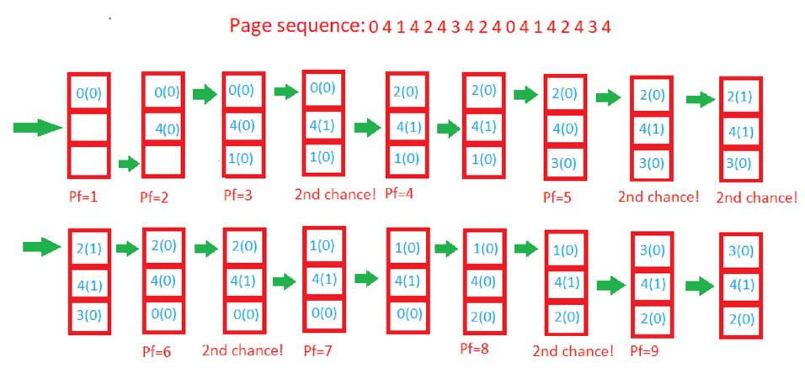
Page Replacement Algorithm-Second Chance Page (SCP) Replacement Algorithm-Example

Slide 91
Clock Page Replacement Algorithm
Second chance algorithm is inefficient as it constantly moves pages around on its list
A better approach is to keep all the pages on a circular list in the form of clock
The hand points to the oldest page
When new page is inserted, R is set to 1
When a page fault occurs, the page being pointed at is inspected
  If its R bit is 0, the page is evicted, the new page is inserted into the clock in its place, R is set to 1 and the hand is advanced one position
  If R bit is 1, it is set to 0 and the hand is advanced to the next page
  The process is repeated until a page is found with R=0

Slide 92
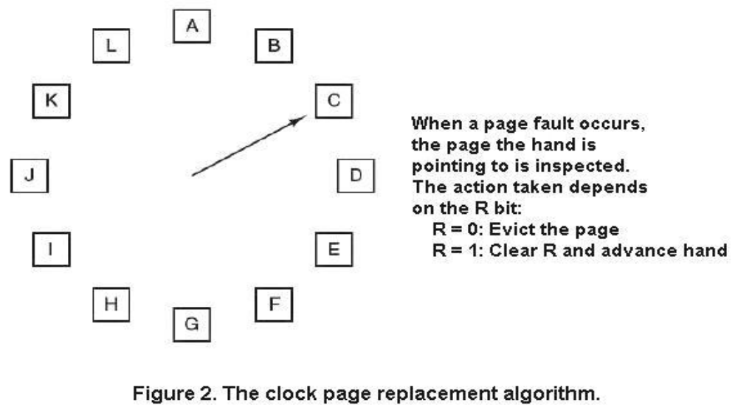
Clock Page Replacement Algorithm

Slide 93
Segmentation
Program is divided into parts known as segments
These segments may vary in size. But there exist a maximum limit to the size of segment
In other words, segmentation is a technique to break memory into logical pieces where each piece (segment) represents a group of related information.
Like paging, a logical address using segmentation consists of two parts:
  1. Segment number
  2. Offset

Slide 94
Segmentation
Because of the use of unequal size segments, segmentation is similar to dynamic partitioning
The difference is that the segments of a same program need not to be contiguous
Segmentation eliminates internal fragmentation but like dynamic partitioning, it suffers from external fragmentation
Each segment consists of a linear sequence of addresses, from 0 to some maximum
Segment length may change during execution. For example, the length of stack segment may be increased whenever something is pushed into the stack

Slide 95
Segmentation
Due to unequal size segments, there is no simple relation between logical and physical address
Analogous to paging, we could create a segment table for each process
Each segment table entry would contain starting address in the main memory of the corresponding segment
Besides that, an entry would also provide the length of the segment so that invalid addresses are not used

Slide 96
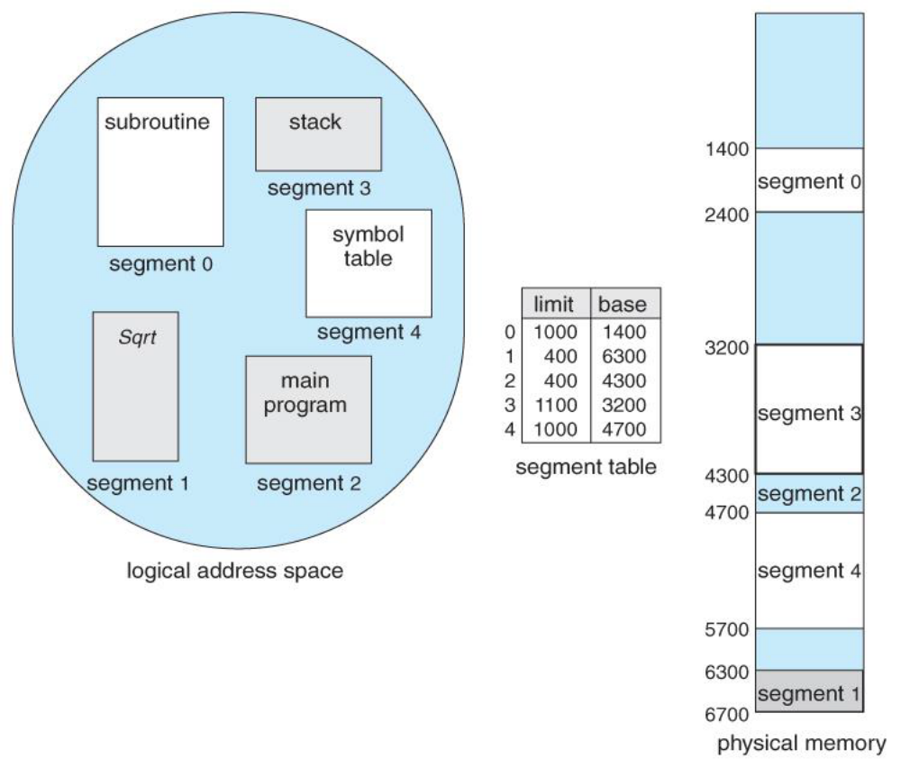
Segmentation

Slide 97
Advantages of Segmentation
It simplifies the handling of growing data structure(OS can grow or shrink the segments as needed)
It allows programs to be altered and recompiled independently, without requiring the entire set of programs to be relinked and reloaded
It lends itself to sharing among a process. A programmer can place a utility program or a useful table of data in a segment that can be referenced by other processes
It lends itself to protection. Because a segment can be constructed to contain a well defined set of programs or data, the programmer/system administrator can assign access privileges in a convenient fashion.

Slide 98
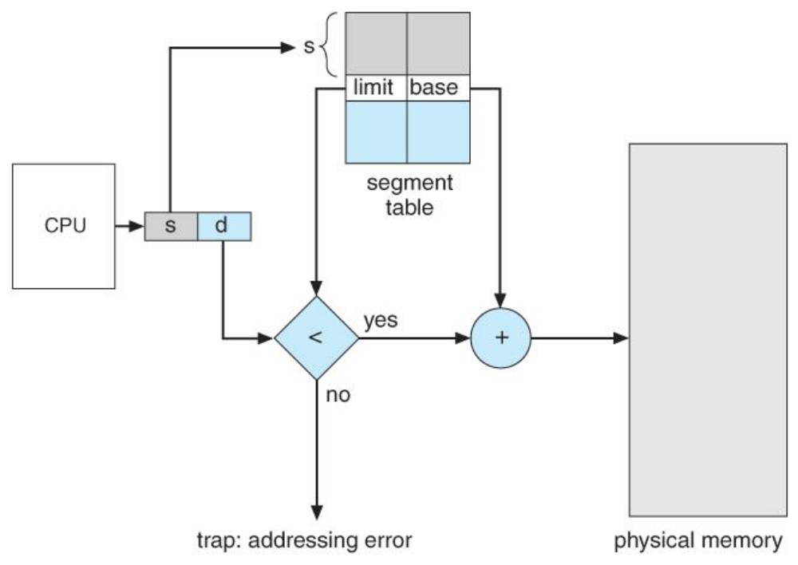
Address Translation in Segmentation
Extract segment number
Use the segment number as index into the process segment table to find the starting physical address of the segment
Compare the offset to the length of segment. If the offset is greater than or equal to the length, the offset is invalid
The desired physical address is the sum of starting physical address of the segment plus the offset

Slide 99
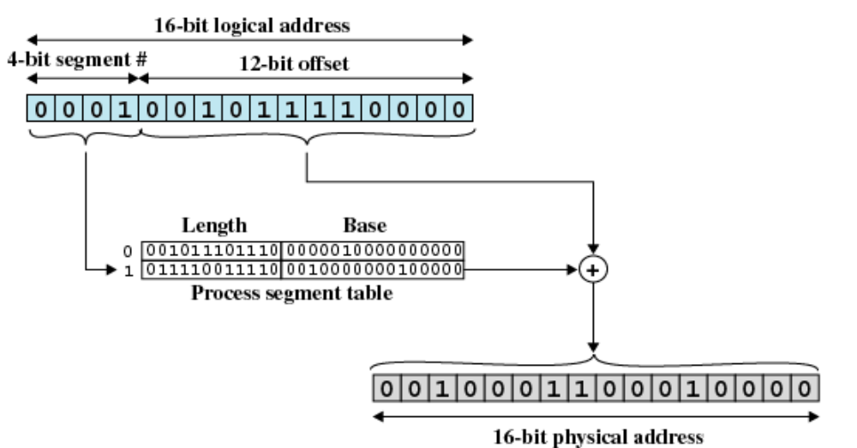
Segmentation Example

Slide 100
Combining paging and Segmentation: Paged Segmentation
In a combined paging and segmentation system, a user’s address space is broken down into a number of segments
Each segment is then divided into fixed sized pages which are equal in length to a main memory frame
Associated with each process is a segment table and a number of page tables, one per process segment
When a process is running, a registers holds the starting address of the segment table for that process
The virtual address is broken down into segment number, page number and offset
Using the segment number, and the segment table, we find the page table for that segment
Then the page number portion of the virtual address is used to look up the corresponding frame number in the page table
The frame number combined with the offset forms the physical address

Slide 101
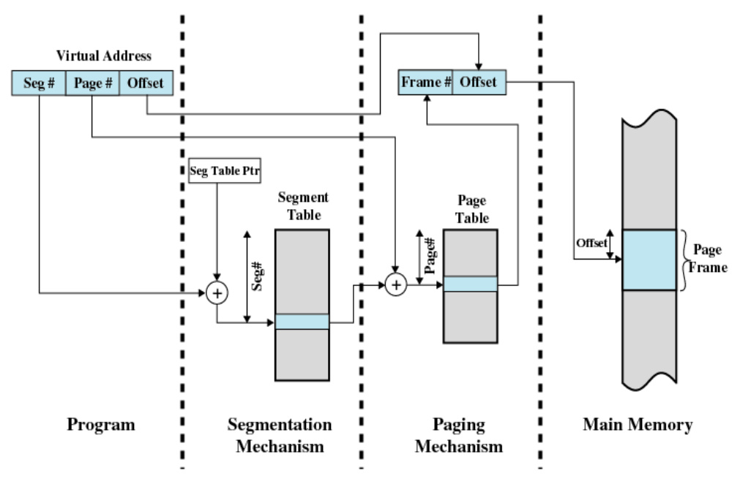
Paged Segmentation

Slide 102
Advanced Virtual Memory: Huge Pages & Transparent Huge Pages (THP)
What are Huge Pages?
Normally, memory is divided into pages, usually 4 KB in x86 systems.
Huge pages are much larger pages, e.g., 2 MB, 1 GB, used to reduce page table overhead and improve TLB efficiency.

Slide 103
Huge pages
Why Huge pages
Reduce TLB misses
  CPU uses TLB (Translation Lookaside Buffer) to cache page table entries.
  Larger pages → fewer entries → fewer TLB misses → faster memory access.
Reduce page table memory usage
  Page tables store mapping from virtual → physical addresses.
  Huge pages require fewer page table entries.
Improve performance
  Databases, HPC (High Performance Computing), virtualization, and large-memory applications benefit.

Slide 104
Huge pages
Linux supports:
  4 KB → normal page
  2 MB → standard huge page
  1 GB → gigantic huge page
Disadvantages
  Internal fragmentation (unused memory inside large pages)
  Less flexible memory allocation
  Requires application or OS support

Slide 105
Mechanism of Huge Pages
Paging Basics Recap
  Logical memory is divided into pages
  Physical memory is divided into frames
  Page table maps virtual page number → physical frame number
  Normal page = 4 KB → many page table entries
Using Huge Pages
  Instead of normal 4 KB pages, huge pages map larger memory blocks
  1 huge page can replace hundreds or thousands of normal pages.
  Page table now has fewer entries → less overhead.
Example
  Process requires 512 MB memory:
    Using 4 KB pages → 131,072 page table entries
    Using 2 MB huge pages → 256 entries only

Slide 106
Types of Huge Pages in Linux
Explicit Huge Pages
  Pre-allocated by OS for specific applications.
  Applications request via mmap or shmget.
Transparent Huge Pages (THP)
  OS automatically converts normal pages to huge pages without application changes.
  Modes:
    always → always try to use huge pages
    madvise → only when app requests via madvise()
    never → disabled

Slide 107
How Paging Works with Huge Pages
Virtual Address Breakdown
Normally: Virtual Address = Page Number + Offset
Huge page: Virtual Address = Huge Page Number + Offset (offset now larger)
Page Table Levels
  Multi-level page tables map huge pages:
    For 2 MB pages → skip one level of page table
    For 1 GB pages → skip two levels
Reduces number of memory accesses for address translation

Slide 108
Example how TLB hit increases
Page size = 4 KB
Huge page size = 2 MB = 512 × 4 KB
Process requests 2 MB memory:
  Normal pages → 512 page table entries
  Huge page → 1 page table entry
TLB hit improvement: 512 → 1 entry

Slide 109
Transparent Huge Pages (THP)
THP is an OS feature that automatically uses huge pages without application modification.
Key Features
  Automatic promotion of small pages to huge pages
  OS decides when to use huge pages
  Available in Linux (enabled by default in many distros)
Modes
  Always: Always try to use huge pages
  Madvise: Only if application requests
  Never: Disabled

Slide 110
Linux Commands
Check Current THP Mode
  cat /sys/kernel/mm/transparent_hugepage/enabled
Output Example:
  always madvise [never]
  The value in [brackets] is the currently active mode
  In this example: never
Temporarily Change THP Mode (Runtime Only)
  Change lasts until reboot
Enable Always Mode
  echo always | sudo tee /sys/kernel/mm/transparent_hugepage/enabled
Enable Madvise Mode
  echo madvise | sudo tee /sys/kernel/mm/transparent_hugepage/enabled
Disable THP (Never Mode)
  echo never | sudo tee /sys/kernel/mm/transparent_hugepage/enabled

Slide 111
Transparent Huge Pages (THP)
Advantages
  Improved performance without developer effort
  Better TLB efficiency
Problems
  Memory latency spikes during page promotion
  Not ideal for real-time systems
  Can cause unpredictable performance

Slide 112
Clock-Pro Algorithm
Advanced CLOCK variant approximating LRU
Separates pages into Hot, Cold, and Test
Uses three clock hands to track page status
Numerical Example:
Frames = 3, Pages = A B C D A B
Cold pages evicted first, repeated access promotes to Hot

Slide 113
Clock-Pro – Example Explained
Reference: A B C D A
Initial: A B C (Cold)
D arrives → evict A (Cold)
A accessed again → promoted to Hot
Shows adaptation to recurring access
Rules
  New page → Cold
  Cold page reused → Hot
  Cold page evicted → Test
  Test page reused → Hot
  Cold pages are evicted before Hot pages

Slide 114
Clock-Pro Solution
1) A → Page fault
Frames: A(C)
Test: —
2) B → Page fault
Frames: A(C) B(C)
Test: —
3) C → Page fault
Frames: A(C) B(C) C(C)
Test: —
4) D → Page fault (Frames full)
Evict A (Cold) → A becomes Test
Frames: B(C) C(C) D(C)
Test: A(T)
5) A → Found in Test
Promote A → Hot
Evict B (Cold) → B becomes Test
Frames: A(H) C(C) D(C)
Test: B(T)
6) B → Found in Test
Promote B → Hot
Evict C (Cold) → C becomes Test
Frames: A(H) B(H) D(C)
Test: C(T)

Slide 115
WSClock Algorithm
Combines:
  Working Set model
  Clock algorithm
Key Parameters
  τ (tau): Working set window (time threshold)
  Reference bit
  Modified bit (dirty bit)

Slide 116
WSClock Algorithm
τ (tau): Working Set Window
  τ is a time threshold.
  It defines how far back in time the OS looks to decide whether a page is actively used.
  If a page was referenced within the last τ time units, it is considered part of the working set.
Reference Bit (R bit)
  Set to 1 when a page is accessed (read/write).
  Reset periodically by the OS.
  Used to check recent usage.
  R bitMeaning1Page was referenced recently0Page was not referenced
Modified Bit (M bit) / Dirty Bit
  Set to 1 when a page is written to.
  Indicates the page differs from disk version.
  M bitMeaning0Clean page (same as disk)1Dirty page (must be written back before removal)

Slide 117
WSClock Algorithm Page States
Clean Page
  Not modified (M = 0)
  Safe to discard
  No disk write needed
  Fast eviction
Dirty Page
  Modified (M = 1)
  Must be written back to disk before eviction
  slow eviction (extra I/O)
Old Page
  Not referenced within τ
  Likely no longer needed
  Eviction candidate

Slide 118
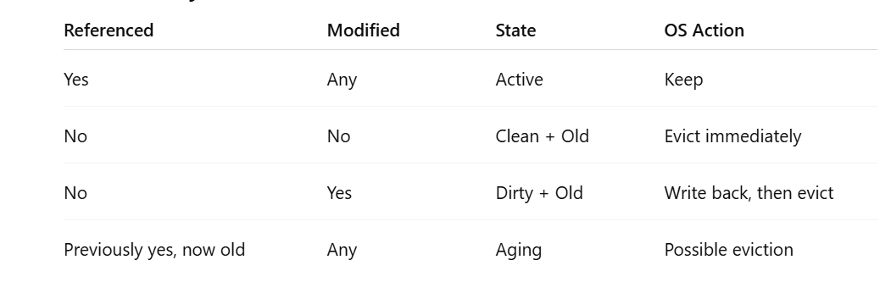

Slide 119
WSClock Algorithm
Page States
Referenced recently → keep
Not referenced + clean → evict
Not referenced + dirty → schedule write-back
Referenced but old → candidate for eviction
Advantages
Considers recency + modification
Reduces unnecessary disk writes
Suitable for multiprogramming systems
Disadvantages
Needs time tracking
More complex than CLOCK

Slide 120
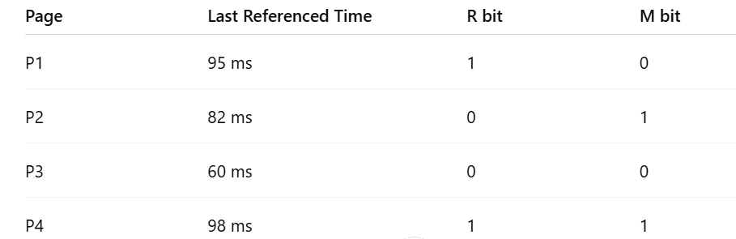
Given
τ = 10 ms
Current time t = 100 ms
Page table info:

Slide 121
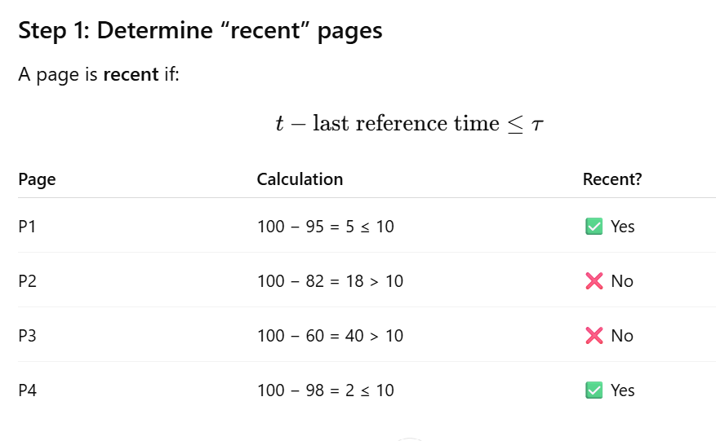

Slide 122
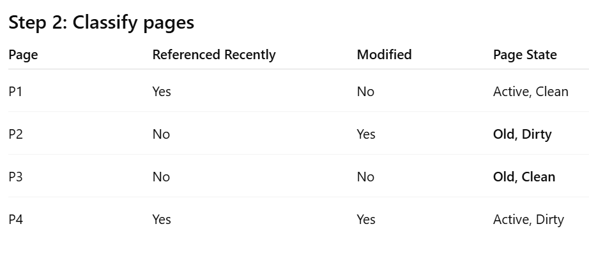

Slide 123
Step 3: Eviction decision
  Best eviction candidate
    P3 (Not referenced + clean)
    Action: Evict immediately
  If P3 is not available (already evicted)
  Next candidate:
    P2 (Not referenced + dirty)
    Action for P2:
    Write back page P2 to disk
    Evict P2 from memory
    This is “write back then evict”

Slide 124
VIRTUALIZATION
Virtualization is a foundational technology in modern computing that enables multiple operating systems and applications to run concurrently on a single physical machine.
By abstracting physical resources such as CPU, memory, storage, and I/O devices, virtualization improves hardware utilization, scalability, isolation, and manageability.
Historically, virtualization originated in mainframe systems to allow time-sharing of expensive hardware.
With the advent of cloud computing, data centers, and multi-core processors, virtualization has become essential for infrastructure efficiency and security.

Slide 125
Principles for Virtualization
Abstraction
  Abstraction hides the complexity of physical hardware by presenting standardized virtual hardware interfaces to guest operating systems. Each virtual machine (VM) believes it owns dedicated hardware, even though resources are shared.
Isolation
  Isolation ensures that one VM cannot interfere with others. Faults, crashes, or security breaches inside a VM remain contained. This principle is critical for multi-tenant cloud environments.
Resource Sharing
  Physical resources are multiplexed among VMs. The hypervisor schedules CPU time, allocates memory, and manages I/O bandwidth efficiently.
Equivalence (Fidelity)
  A program running inside a VM should behave identically to how it would run on physical hardware, except for performance differences.
Performance Efficiency
  Most instructions should execute directly on the hardware without hypervisor intervention. Hardware-assisted virtualization plays a key role here.

Slide 126
Hypervisor Architectures
A hypervisor (or Virtual Machine Monitor, VMM) is software that lets multiple operating systems run on a single physical machine.
It manages hardware resources (CPU, memory, storage) and allocates them to virtual machines (VMs) without interference.
This improves hardware utilization, reduces costs, and provides flexibility in cloud and server environments.

Slide 127
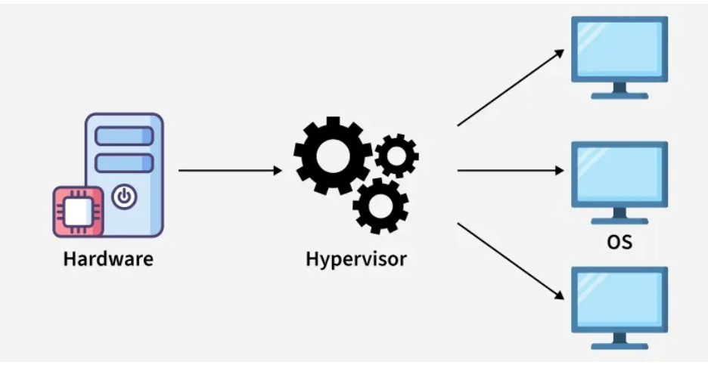
Hypervisor Architectures
A hypervisor runs on hardware or a host OS to create and manage virtual machines (VMs),
each with its own virtual CPU, memory, storage, and network.
It intercepts guest OS requests and translates them to physical hardware, ensuring isolation, security, and stability.

Slide 128
Hypervisor Architectures
Type 1 Hypervisors (Bare-Metal)
  Type 1 hypervisors run directly on hardware without a host operating system. They offer high performance, security, and are commonly used in servers and clouds.
Characteristics:
  Direct hardware access
  Minimal attack surface
  Better performance and scalability

Slide 129
Hypervisor Architectures
Type 2 Hypervisors (Hosted)
  Type 2 hypervisors run on top of a conventional host operating system. They are simpler to install but have higher overhead.
Characteristics:
  Relies on host OS drivers
  Suitable for desktops and testing
  Lower performance compared to Type 1

Slide 130

Hypervisor Architectures

Slide 131
Hypervisor Architectures
Monolithic Hypervisors
  In a monolithic hypervisor, most system services run inside the hypervisor kernel itself, including:
  Device drivers
  Memory manager
  CPU scheduler
  I/O stack
  The hypervisor acts almost like a mini operating system.
  VMware ESXi and Xen (early versions) are classic examples.
Key Architectural Characteristics
Drivers execute in kernel mode
Fewer context switches
Tight coupling of components

Slide 132
Hypervisor Architectures
Advantages
High performance (direct driver access)
Low I/O latency
Efficient for enterprise servers
Disadvantages
Large trusted computing base (TCB)
Driver bugs can crash the entire system
Larger attack surface

Slide 133
Hypervisor Architectures
Microkernel Hypervisor Architecture
  A microkernel hypervisor keeps only essential functionality inside the hypervisor:
    CPU scheduling
    Memory isolation
    Interrupt handling
All non-critical services, especially device drivers, run in user space or separate service VMs.
Modern Xen follows this approach.
Key Architectural Characteristics
  Drivers outside the hypervisor
  Strong fault isolation
  Message-passing based design

Slide 134
Advantages
High security
Fault isolation (driver crash ≠ system crash)
Smaller attack surface
Disadvantages
More context switches
Slightly higher latency
Complex design

Slide 135

Hypervisor Architectures

Slide 136
Hypervisor Architectures
Hosted Hypervisor Architecture (Type-2 as Architecture)
Type-2 can be treated architecturally.
In hosted architecture, the hypervisor runs as an application on top of a host OS and relies entirely on the host for:
  Device drivers
  Memory management
  Scheduling support
Example: VMware Workstation
Architectural Characteristics
  Hypervisor in user space
  Heavy reliance on host OS
  Hardware access is indirect
Architectural Implication
  Not suitable for production servers
  Useful for development and testing

Slide 137
Hypervisor Architectures
Hybrid Hypervisor Architecture
Concept
A hybrid architecture combines:
Type-1 execution (runs on hardware)
Host OS components for driver reuse
Best example: KVM
Why this matters
Reuses mature Linux drivers
Maintains near bare-metal performance
Extremely popular in cloud platforms

Slide 138
Virtualization of Memory in Multi-Core Systems
Memory virtualization must provide each VM with the illusion of contiguous physical memory while efficiently sharing limited RAM.
Challenges include:
  Address translation overhead
  Memory isolation
  NUMA awareness in multi-core systems
Address Translation
  Guest OS uses virtual addresses that are mapped to guest physical addresses. The hypervisor then maps these to machine physical addresses.

Slide 139
Virtualization of Memory in Multi-Core Systems
Shadow Page Tables
  Early virtualization systems used shadow page tables maintained by the hypervisor to translate addresses. This approach introduced high overhead due to frequent synchronization.
Hardware-Assisted Paging
  Modern CPUs support nested paging (e.g., Extended Page Tables or Rapid Virtualization Indexing). This allows hardware to handle two-level translation efficiently.
Memory Overcommitment
  Hypervisors may allocate more virtual memory than physically available RAM, relying on techniques such as:
    Ballooning
    Page sharing (deduplication)
    Swapping

Slide 140
Virtualization of I/O in Multi-Core Systems
I/O Virtualization Challenges
  I/O devices are stateful and slow compared to CPUs. Efficient sharing while maintaining isolation is difficult.
Device Emulation
  The hypervisor emulates standard hardware devices. This ensures compatibility but increases overhead due to context switches.
Paravirtualized I/O
  Guest OS uses special drivers to communicate efficiently with the hypervisor, reducing overhead.
Direct Device Assignment
  Technologies like IOMMU allow safe direct access to physical devices by a VM, improving performance while preserving isolation.

Slide 141
Memory Isolation and Protection in Virtualized Environments
Importance of Memory Isolation
  Memory isolation prevents unauthorized access between VMs and protects the hypervisor from malicious guests.
Hardware Support
  CPU features enforce memory access permissions at multiple levels. Unauthorized memory access triggers traps handled by the hypervisor.
Protection Mechanisms
  Page-level access control
  Address space separation
  IOMMU for DMA protection
Security Implications
  Weak isolation can lead to VM escape attacks. Strong memory protection is fundamental to secure virtualization.

Slide 142
Case Study – Memory Management in Linux
Linux Memory Architecture
  Linux uses virtual memory with demand paging. Each process has its own address space protected by the kernel.
Paging and Swapping
  Linux manages RAM using page replacement algorithms and can swap pages to disk under memory pressure.
Linux as a Guest OS
  When running inside a VM, Linux cooperates with the hypervisor through paravirtualized drivers for memory and I/O efficiency.

Slide 143
Case Studies – Virtualization Technologies
Xen
  Xen introduced paravirtualization, where guest OSes are modified to interact efficiently with the hypervisor. Modern Xen also supports hardware-assisted virtualization.
VMware
  VMware popularized full virtualization using binary translation and later adopted hardware-assisted virtualization. Its memory management techniques such as transparent page sharing are widely studied.
AMD-V
  AMD-V provides hardware extensions for CPU and memory virtualization, including nested page tables. These features significantly reduce hypervisor overhead and improve performance.

Slide 144
Thank You

